Slide 1


Progress Since PRAGMA 19
Planning for PRAGMA’s Future
PRAGMA 20
2-4 March2011
University of Hong Kong

Slide 2

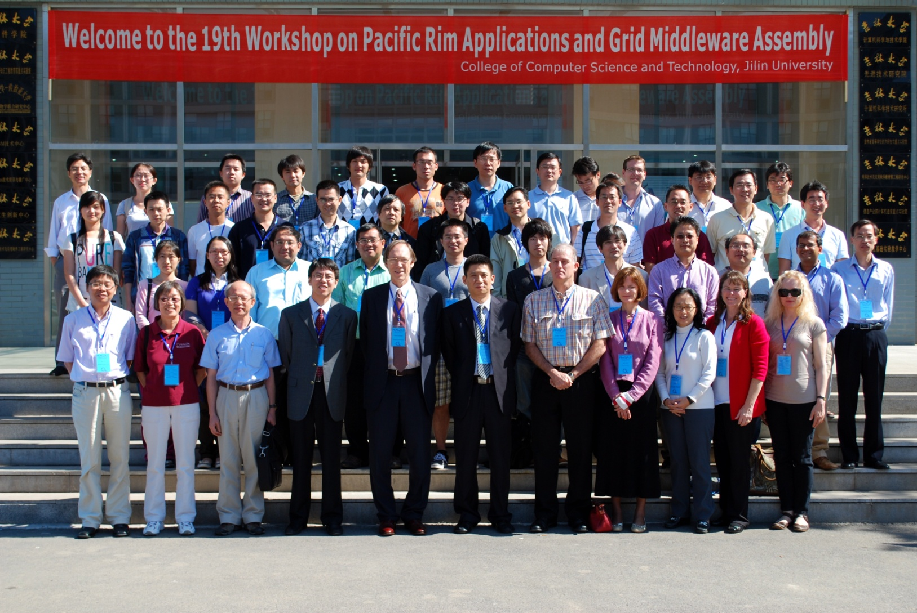

Slide 3

Thank you for including PRAGMA

Slide 4
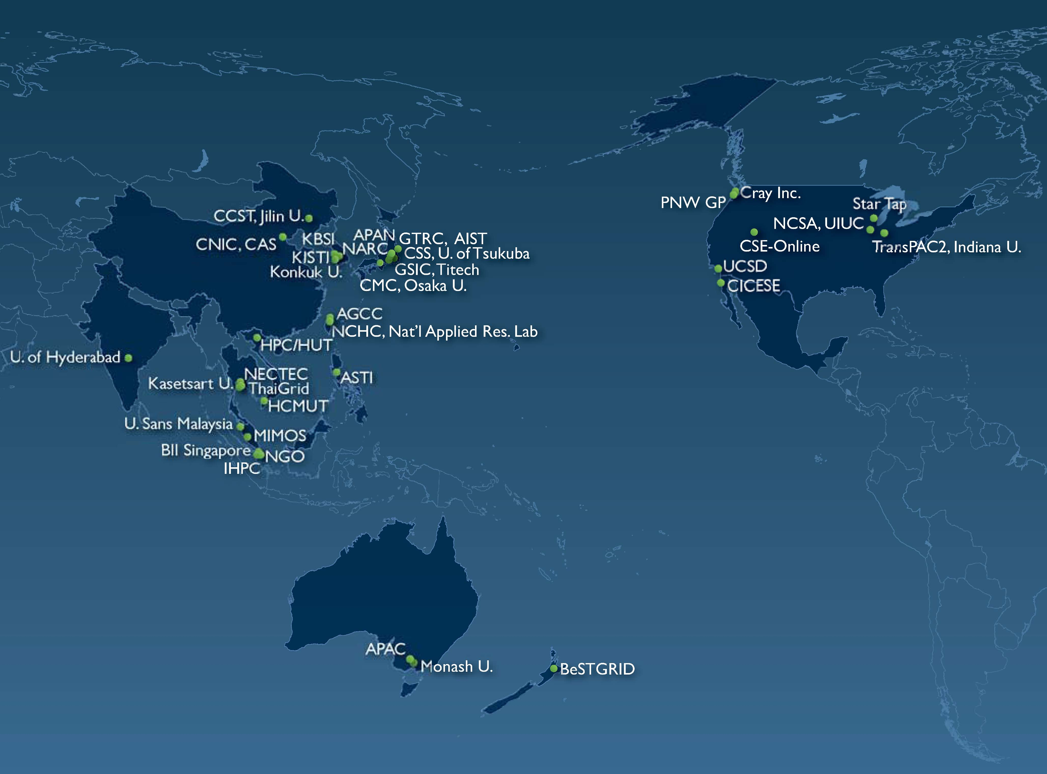
PRAGMA
A Practical Collaborative Framework
IOIT-VN
Strengthen Existing and Establish New Collaborations
Work with Science Teams to Advance Grid Technologies and Improve the Underlying Infrastructure
In the Pacific Rim and Globally
http://www.pragma-grid.net
Notes:
35 Members

Slide 5
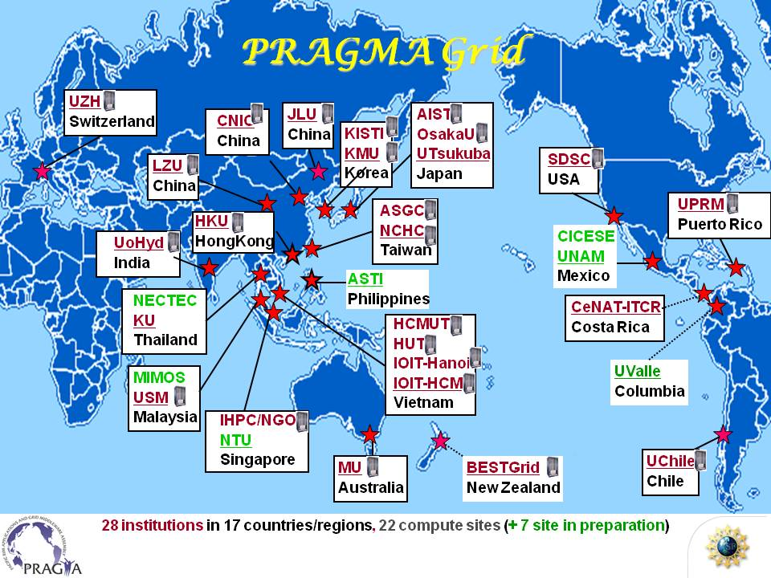
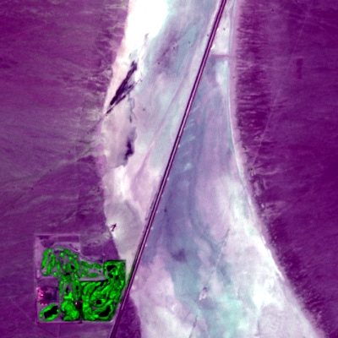
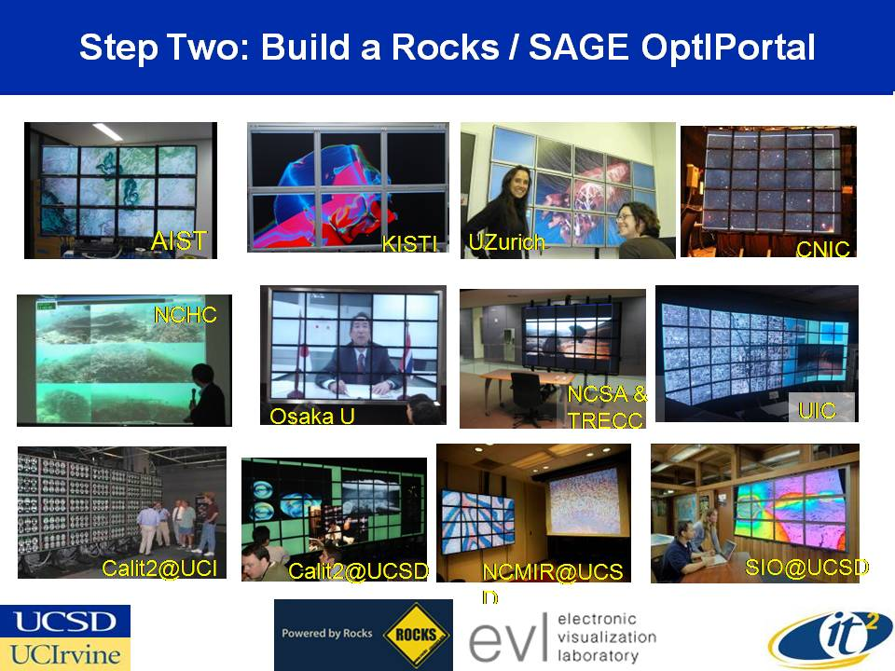
Working Groups: Organize Activities
Resources
Biosciences
March 2010
Telescience
GEO

Slide 6
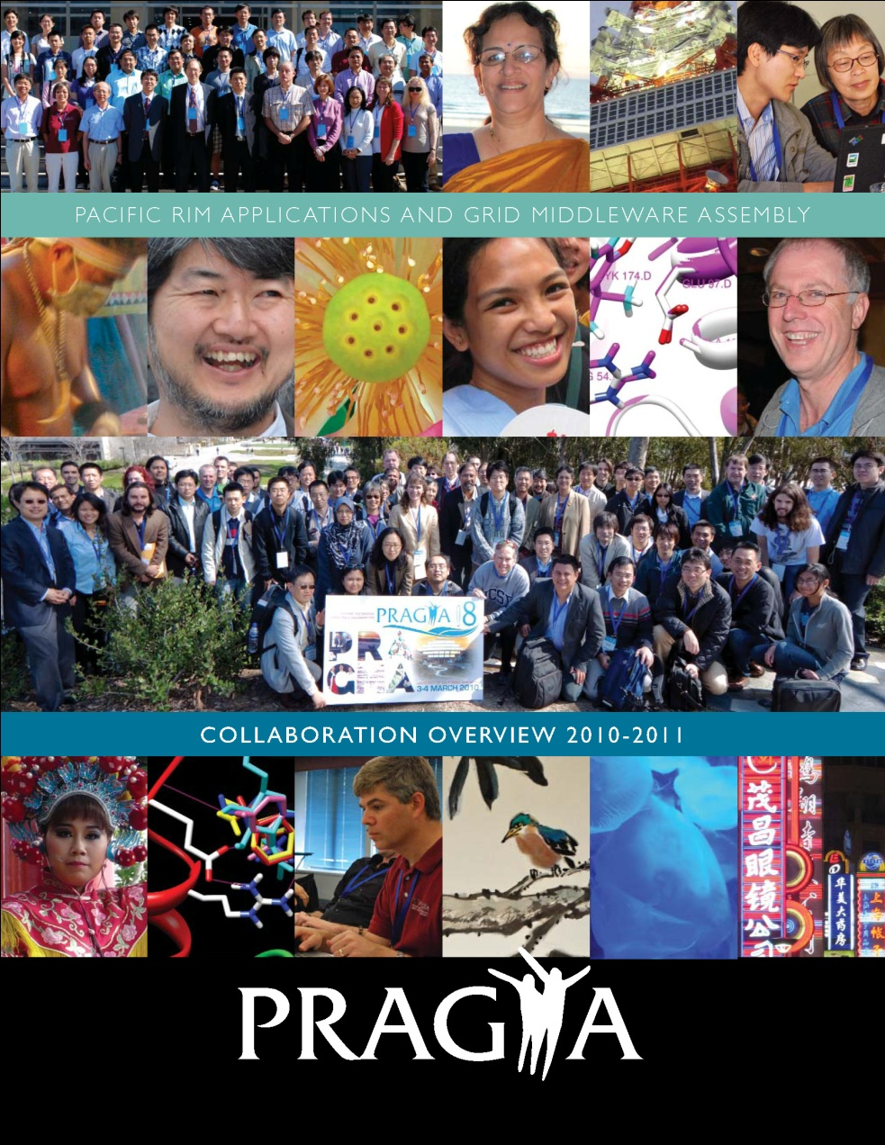
PRAGMA 2010 - 2011
Highlights
Select Software
Institutional Benefit
Partners
GLEON, CREON
PRIME, MURPA
Working Groups and Workshops
Participants and Sponsors
People, Science, People, Technology, People, Students, People, Culture, People

Slide 7
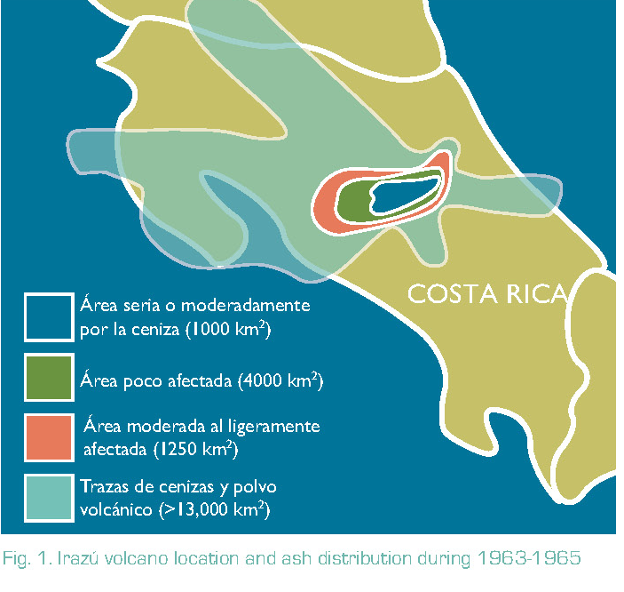
One Story, Three Perspectives
Societal
Irazu volcano location and ash distribution 1963-5
Technical
NG-TEPHRA, Nimrod, EC2
Collaborative
PRAGMA 18 Development Institute
Costa Rica Institute of Technology,
Monash University, UCSD
Resources Working Group
National University of Costa Rica,
Citizen’s Network of Meteorological Stations
Notes:
National University of Costa Rica, Citizen’s Network of Meteorological Stations
Ariound San Jose

Slide 8
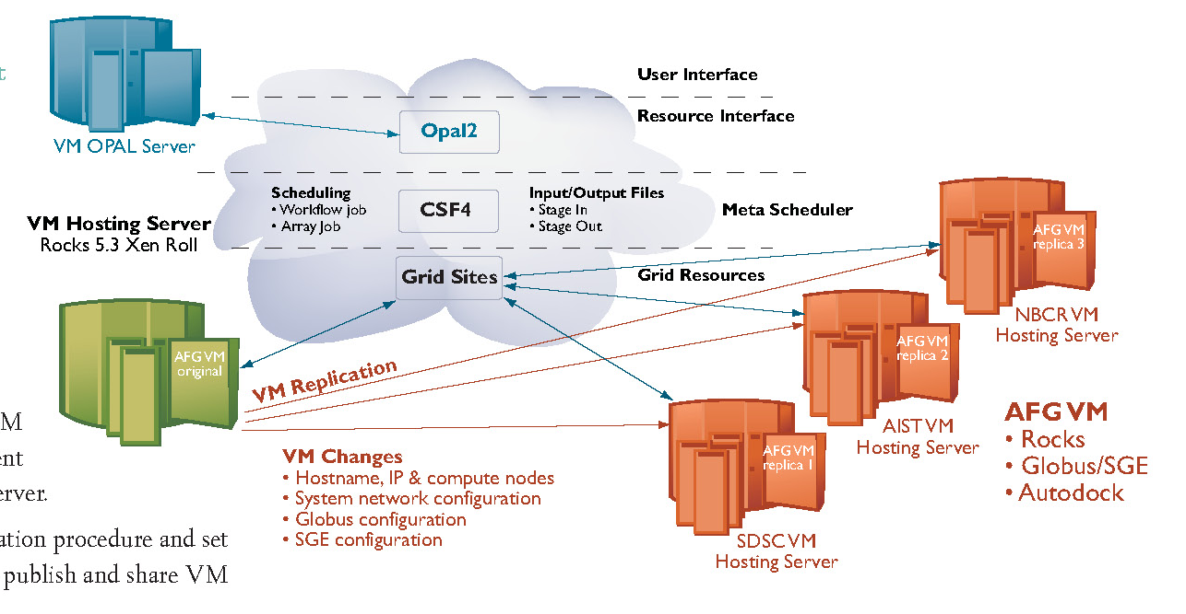
From Grid to Cloud: VM Image Replication
Previous Model on PRAGMA Grid
Set up each machine separately
Future Model on PRAGMA Grid
Migrate “Images” of working pipeline
MORE TO COME FROM THE RESOURCES GEO WG
Societal Impact
Avian Flu Grid
Collaboration
AIST, UCSD, NBCR
Jilin U: CSF4
Biosciences and Resources WGs

Slide 9
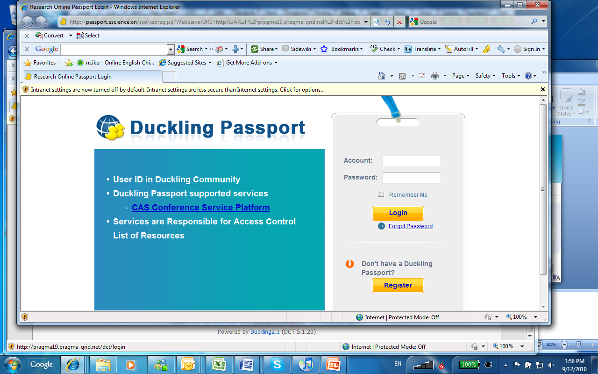

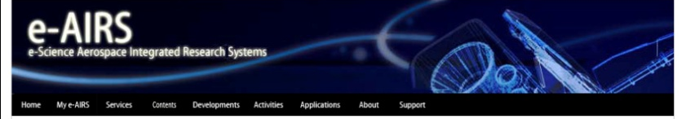
Member Contributions
Duckling
Collaboration Environment for e-Science
CNIC
PRAGMA Workshop Framework
Gfarm File System
U. Tsukuba, AIST
E-AIRS for Computational Fluid Dynamics
KISTI
Used in many universities in Korea

Slide 10
Benefits
“By actively participating in a large community such as PRAGMA, we can contribute our technology to real-world use in science.” Osaka, NICT
“Above all, PRAGMA brings great value to CCST in terms of broadening international collaboration, engaging applications, publishing scientific papers, and cultivating student.” Jilin University
“There are always PRAGMA members working on interesting problems ready to push the boundaries of what we do.” Monash University
“Learning from the PRAGMA collaboration, NCHC has built grid application platforms which have led to extensive involvement from NARL.” NCHC, NARL
Notes:
Testing and Users
PRAGMA Workshops
Promotion and Use
Feedback and Use
Use and Incorporation in Avian Flu Grid Virtual Image
Collaborations and Publications
Resources, Expertise
Experience, Knowledge
Friendships

Slide 11
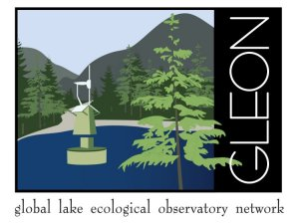

Partnerships
Global Lake Ecological Observatory Network (GLEON)
Run model on lake(s)
Setup a virtual cluster running Condor at SDSC, develop a rocks roll for GLEON
Came from discussions at PRAGMA 19
Coral Reef Ecological Observatory
Sharing equipment (meeting organized by NCHC)
Project started at PRAGMA 18,
NECTEC, UCSD, NCHC
Notes:
We were a bit surprised to learn that no one source lists all the lakes of the world and their key attributes – much less in an easily accessible repository. The number is finite and not that large (~350 million; Downing et al. 2006), and probably does not change much. We decided to create a repository, LakeBase, that represents lakes of the world and their associated data of interest to lake scientists. We have a long way to go, but we’re off to a good start. LakeBase is changing rapidly as we load data sets and provide additional functionality.
LakeBase has two main interfaces – a map (Fig. 1) and a free-text search (Fig. 2).

Slide 12
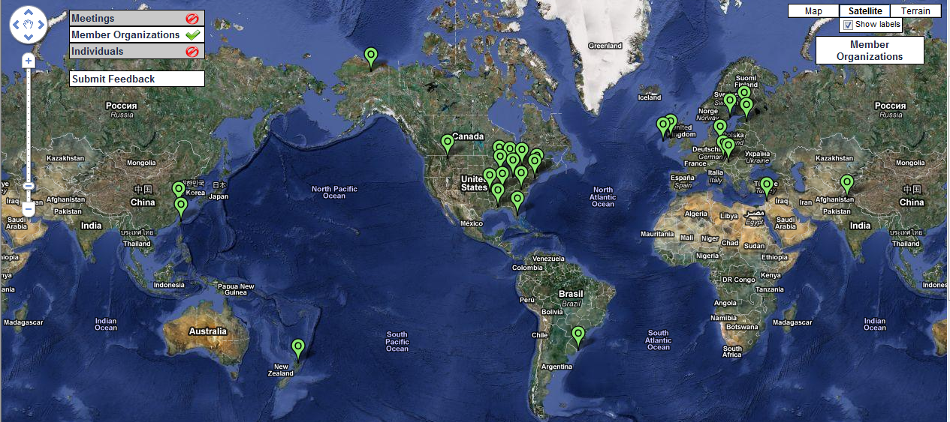
GLEON: revolutionizing understanding of aquatic ecosystems through an international grassroots network of people, data, and lake observatories
31 Site Members (sites shown)
259 Individual Members (2Mar11)

Slide 13
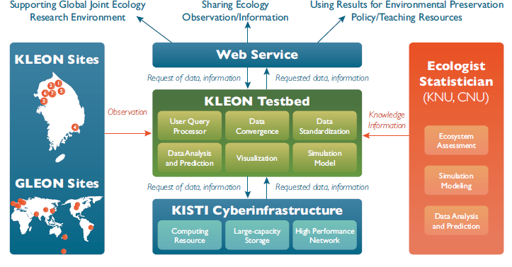
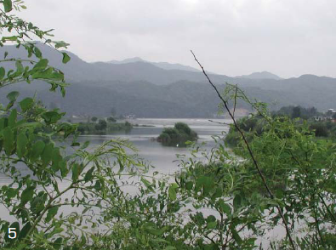
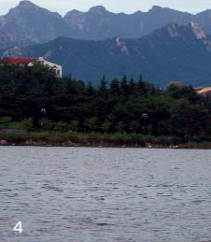
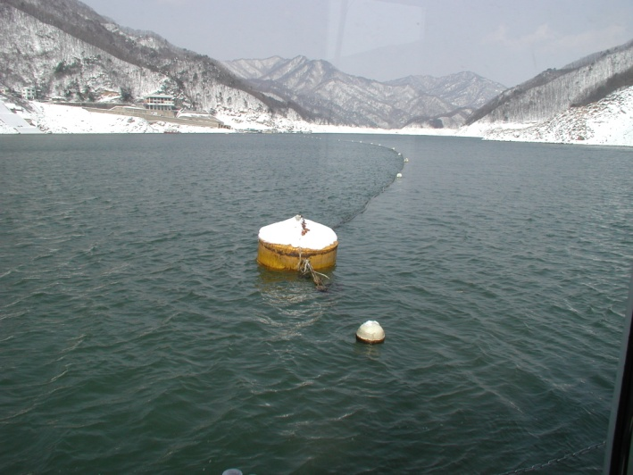
PRAGMA + GLEON + KISTI + KEON Korean Lake Ecological Observatory Network (KLEON)
Seven Sites
Architectural Framework
Linked with Konkuk U
Notes:
Persistence pays off, as do good people, a larger vision, and a global network
Picture lower right from Lake Soyang February 2005

Slide 14



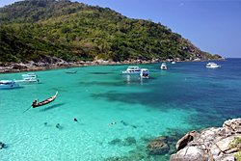

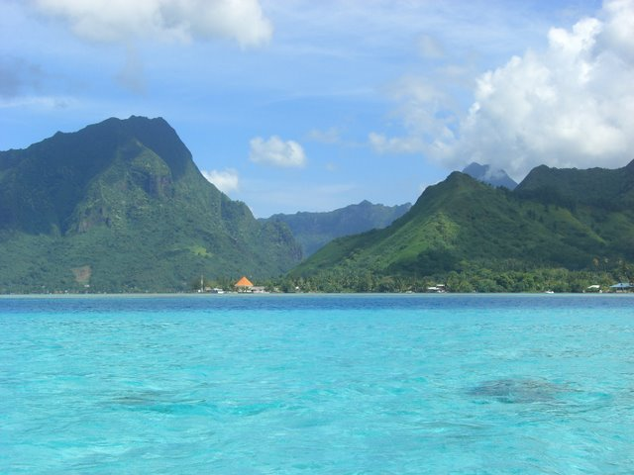
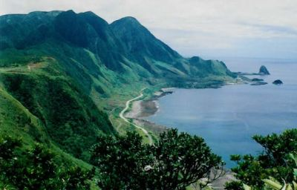

Great Barrier Reef
GEO TELESCIENCE WG
Racha Island
Moorea
Orchid Island (Lanyu)

Slide 15
Path of Progress
PRAGMA 17, Hanoi, October 2009
Panel on Virtualization
PRAGMA 18, San Diego, March 2010
PRAGMA Development Institute
Commitment to use EC2
Commitment to move images between 2 sites
PRAGMA 19, Jilin, September 2010
Move images between three sites
PRAGMA 20, Hong Kong, March 2011
Demo and ???

Slide 16
March 2010

Slide 17

PRAGMA Grid/Clouds
UZH
Switzerland
UZH
Switzerland
CNIC
China
JLU
China
AIST
OsakaU
UTsukuba
Japan
KISTI
KMU
Korea
IndianaU
USA
LZU
China
SDSC
USA
LZU
China
ASGC
NCHC
Taiwan
HKU
HongKong
UoHyd
India
ASTI
Philippines
NECTEC
KU
Thailand
CeNAT-ITCR
Costa Rica
From PRAGMA 19 to PRAGMA 20
VM sites from 4 to 9
SDSC, AIST, NCHC, OsakaU,
IndianoU, USM-CS, ASTI, MIMOS, LZU
VM applications from 1 to 6
SDSC: Avian Flu Grid, Autoduck, Blast
AIST: Bloss, Geogrid
NCHC: F-Motif
HCMUT
HUT
IOIT-Hanoi
IOIT-HCM
Vietnam
MIMOS
USM
Malaysia
MU
Australia
BESTGrid
New Zealand
UChile
Chile
26 institutions in 16 countries/regions, 22 compute sites, 9VM sites (+ 6 site in preparation)
2 March 2011

Slide 18
Demos: Show Accomplishment – Others to Use
Coral Sensor Network at Racha Island, Thailand
Development of Multi-scale Global Earth Observation Platform for Monitoring and Assessment in Typhoon Induced Disasters
Virtualization Framework for Data Service on Global Scale Lake Observatory Network
Grid Computing in High Energy Physics in China
VM Interoperability between NCHC, SDSC, and AIST - Towards VM-based PRAGMA Infrastructure
Opal-Sigiri: Software as a Service on PRAGMA Testbed
Is Cloud Computing Suitable for High Performance Computing (HPC) Application?
Towards a Parallel Ensemble Scientific Modeling Service in the Windows Azure Cloud
Calling the Cloud: The Gfarm-iPhone Bridge
The Performance Analysis of Molecular Dynamics RAD GTPase with AMBER Application on Cluster Computing Environment
Conference Service Platform: Architecture and Implementation
Large-eddy Simulation of Flows and Pollutant Removal in Street Canyons of Different Aspect
Notes:
Coral Sensor Network at Racha Island, Thailand
Development of Multi-scale Global Earth Observation Platform for Monitoring and Assessment in Typhoon Induced Disasters
Virtualization Framework for Data Service on Global Scale Lake Observatory Network
Grid Computing in High Energy Physics in China
VM Interoperability between NCHC, SDSC, and AIST - Towards VM-based PRAGMA Infrastructure
Opal-Sigiri: Software as a Service on PRAGMA Testbed
Is Cloud Computing Suitable for High Performance Computing (HPC) Application?
Towards a Parallel Ensemble Scientific Modeling Service in the Windows Azure Cloud
Calling the Cloud: The Gfarm-iPhone Bridge
The Performance Analysis of Molecular Dynamics RAD GTPase with AMBER Application on Cluster Computing Environment
Conference Service Platform: Architecture and Implementation
Large-eddy Simulation of Flows and Pollutant Removal in Street Canyons of Different Aspect

Slide 19
Monash University Research Program Abroad (MURPA)
Four at UCSD
Geoff Pascoe – Sensor Networks
James Wetter – Visualization
Wai Keung Yiu Man Lung - Workflows
Lin Wei – Workflows and Avian Flu Grid
Two at UIUC
Edgar Kautzner – Augmented Reality
Jian Zhang – Parallel Debugging Blue Waters
Presentations on 17/18 March
Remotely
Notes:
Student1: Edgar Kautzner
Childhood Obesity Study:
Project was to evaluate the child obesity monitoring system in Illinois (CHOIS) and subsequently conduct a study to determine the potential feasibility and effectiveness of a similar electronic health record-based monitoring program in Australia.
Student 2: Jian Zhang:
Parallel debugging on Blue Waters Supercomputer:
The purpose of this project was to update PTP and the Guard parallel debugger to work within the Blue Waters Infrastructure at NCSA Illinois.

Slide 20
Pacific Rim Experiences for Undergraduate (PRIME): 8th Year
Conduct research
Build our collaborations
Publish papers/create software
Create future
Osaka University
National Institute for Information and Communications Technology
Doshisha University
National Center for High-performance Computing
National Taiwan University
Monash University
Computer Network Information Center
Universiti Sains Malaysia
University of Hyderabad
University of Auckland
National Center for Earthquake Engineering
Taiwan Forest Research Institute

Slide 21
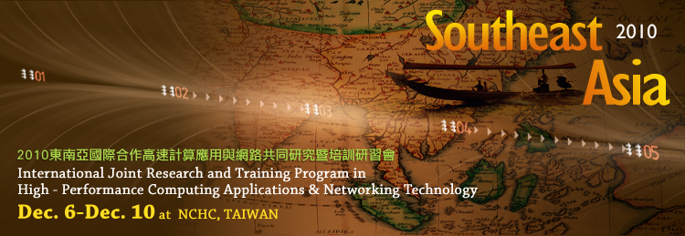
Joint with PRAGMA Institute
Introduce colleagues from Southeast Asia to PRAGMA
Vietnam, Malaysia, Philippines
Indonesia - Welcome

Slide 22
Opportunities for PRAGMA and Hong Kong Researchers
Participating with Working Group Leads
Resources: Cho-li Wang
GEO: Chun-Ho Liu
Telescience: Ji Chen
Biosciences: You Qiang Song
GEO-science Workshop
Simulation of Flow and Pollutant (GEO)
Welcome

Slide 23
PRAGMA Future Challenges
Products
Tangible outcomes for others to use
Application communities
Science drivers focus our work
Communities provide broad dissemination and use
Education
Engage new members
Staying renewed
Society
Our work must fit on context of our world
Everyone needs to contribute
Active participation
Concrete Goals

Slide 24

Thank You to the Organizers!
Congratulations on 100 years of
Knowledge
Heritage
Service
Active Participation!
Concrete Goals for PRAGMA 21

